Slide 1
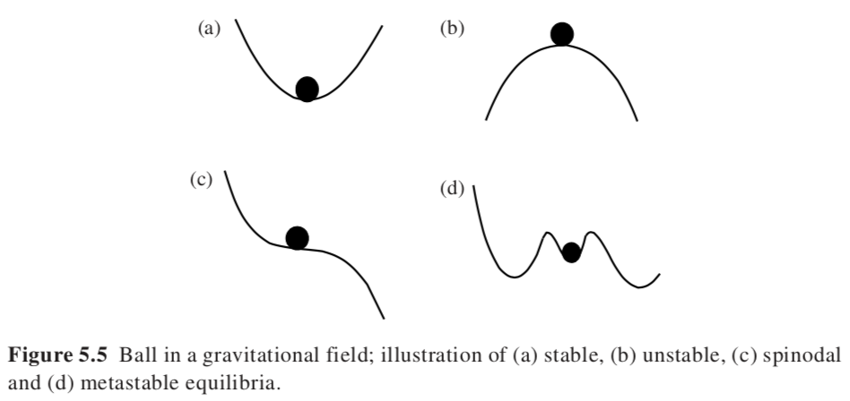
Phase Stability
Phase Stability

Slide 2
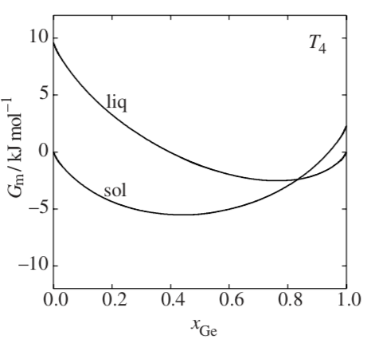
Supercool/Superheat/Supersaturate
At the equilibrium melting/freezing point or equilibrium concentration for precipitation the driving force for phase separation, ΔG = ΔH – T ΔS = 0. So, a phase will only form by lowering the temperature below the melting point or increasing the concentration above the solubility limit. This is related to “critical slowing down”. At the critical point nothing happens, or anything can happen, there is no thermodynamic direction for the process.
Cooling below the melting point produces a supercooled liquid, raising the concentration above the saturation limit produces a supersaturated solution. You can also heat a solid above the equilibrium melting point and produce a superheated solid.
The rate of phase separation depends on two factors:
ΔG and kinetics. Kinetics slows exponentially at lower temperatures D ~ exp(K/(T-T₀)). The thermodynamic driving force, exp(-ΔG/kT), decays at higher temperatures, so a maximum in growth rate results below the equilibrium in the super cooled liquid state.
ΔG = ΔH – T ΔS

Slide 3
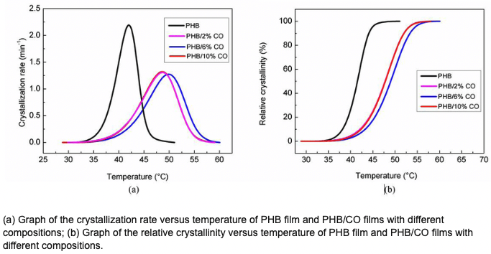
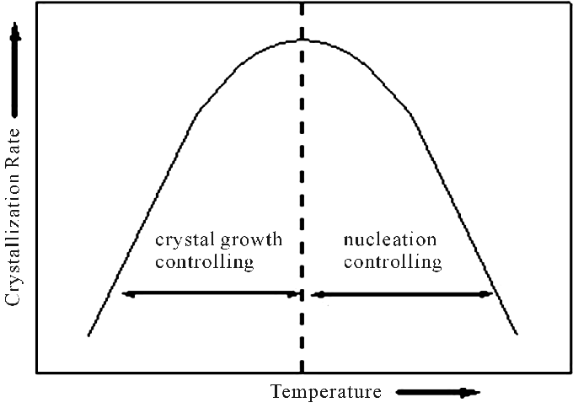

Supercool/Superheat/Supersaturate
To homogeneously form a crystal, you need to 1) form a nucleus or seed then 2) grow from the seed. At deep quench you get a lot of seeds but slow growth since transport is slow. At high temperature you see few seeds, but the kinetics are fast.
The rate of phase separation depends on two factors:
ΔG and kinetics. Kinetics slows exponentially at lower temperatures D ~ exp(K/(T-T₀)). The thermodynamic driving force, exp(-ΔG(T)/kT), decays at higher temperatures, so a maximum in growth rate results below the equilibrium in the super cooled liquid state.

Slide 4
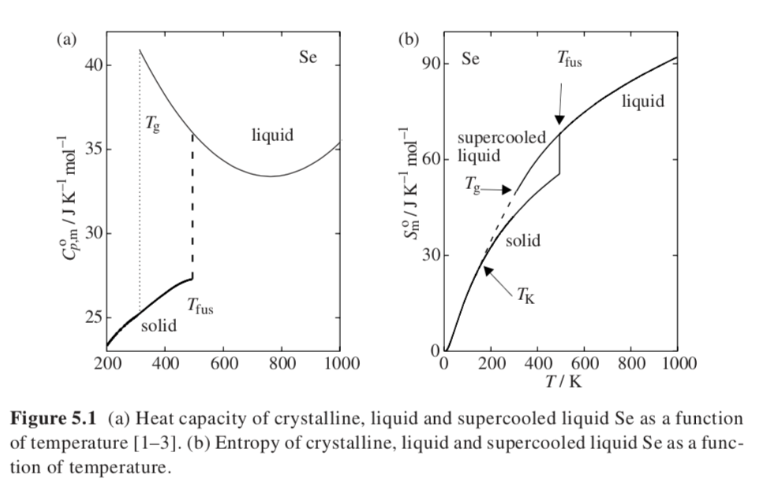
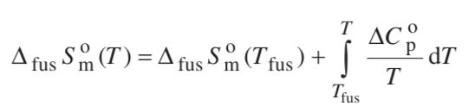
Kauzmann Paradox,
a thermodynamic basis for the glass transition
The entropy of the liquid becomes smaller than the entropy of the solid at the Kauzmann temperature, T_{K}. This could be the infinite cooling glass transition temperature.
Selenium like sulfur can form chain molecules
Selenium forms a hexagonal crystal of helical chains (slow kinetics)

Slide 5
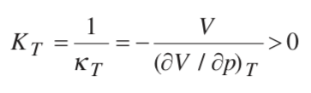
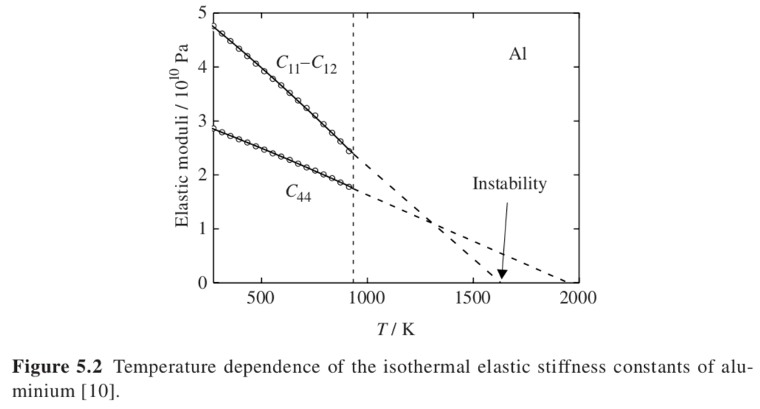


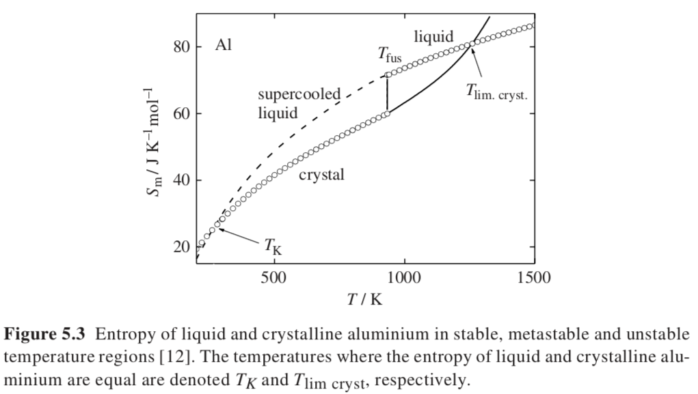

Superheating and Melting
Superheating can occur since melting occurs at surfaces and if the surfaces are stabilized then superheated solids can be produced
Growth of a liquid phase relies on growth of a mechanical instability
A mechanical instability will not spontaneously grow if it occurs in a meta-stable region in T and P:
(dG/dx)=0 defines equilibrium or binodal; (d²G/dx²) = 0 defines the metastable limit or spinodal
(d³G/dx³) = 0 defines the critical point
dG = -SdT + Vdp
Metastable region defined by
(d²G/dp²)_{T} = (dV/dp)_{T} < 0 and (d²G/dT²)_{p} = -(dS/dT)_{p} < 0
First requires that the bulk modulus be positive,
Second requires positive heat capacity, (dS/dT)_{p} = C_{p}/T > 0
-S U V
H A
-p G T
933K = T_{m,Al}
Shear modulus goes to 0 at highest possible supercritical solid

Slide 6
Thermal (energy) fluctuations are the basis of thermodynamics
Thermodynamic Hypothesis:
Systems are always probing free energy space (temperature, composition, pressure, magnetic field, electrical field, energy, extent of reaction, etc.) through random fluctuations. This enables the attainment of the lowest free energy at an equilibrium state.
This hypothesis leads to consideration of the partial derivatives of free energy as defining features in free energy space particularly critical points (d³G/dx³=0; d²G/dx²=0; dG/dx=0), equilibrium (binodal) points (dG/dx=0), and spinodal points (d²G/dx²=0).
Map of energy in 3d space at one time slice
https://upload.wikimedia.org/wikipedia/commons/2/2a/Quantum_Fluctuations.gif

Slide 7
The book considers first a reversible chemical reaction A <=> B
Cyclohexane from boat to chair conformation for instance
Transition
State
Transition
State
Boat
The equilibrium point depends on temperature, k_{B}T
Chair
Metastable
Chair
As temperature changes you can observer a different mix of states, E = k_{B}T ~ 2.5 kJ/mole at RT
But fluctuations allow for 0.1 % boat conformation. At 1073K 30% boat. Probability is exp(-E/kT).
The percent in boat can be measured using NMR spectroscopy.

Slide 8
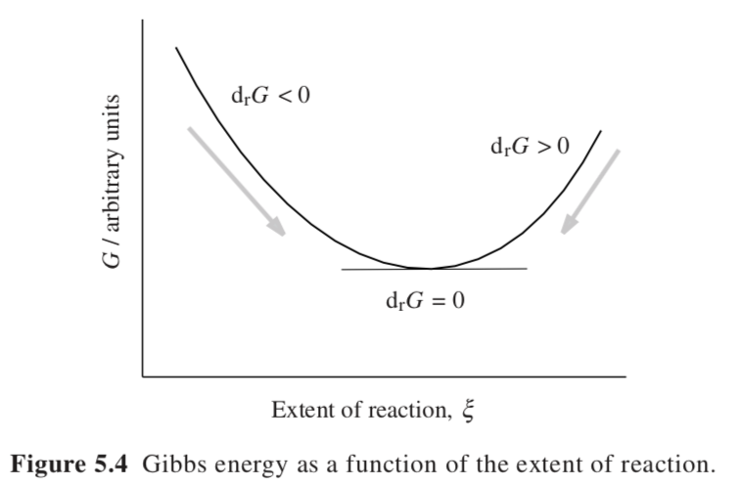


A <=> B
Affinity
At temperature T, the reaction is like a spring bouncing between A and B oscillating about the equilibrium point since any deviation from equilibrium increases the free energy.
Extent of reaction would be the conversion from chair (A) to boat (B), for instance, at a temperature T. The minimum, (dG/dξ) = 0 is the equilibrium point. The free energy plot can be concave up (stable equilibrium) concave down (unstable), flat (critical point/temperature), and other shapes

Slide 9
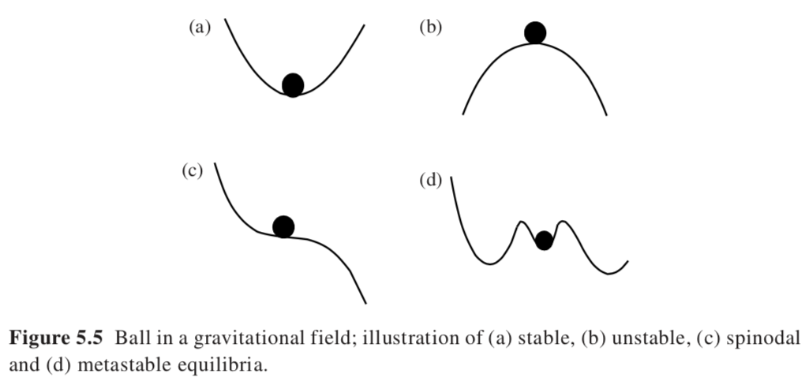
Stable dG/dx = 0
Unstable
Spinodal d²G/dx² = 0
Metastable (This can depend on your vantage point)

Slide 10
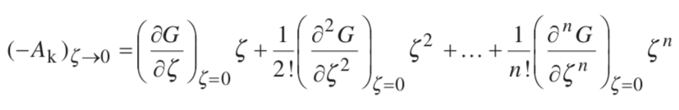

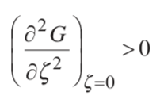
Affinity as a Taylor series in the reaction coordinate
ζ is a fluctuation in a reaction coordinate, T, p, m, ξ, etc.
At equilibrium, the affinity is 0 so = 0
If then the equilibrium is stable

Slide 11



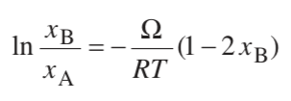
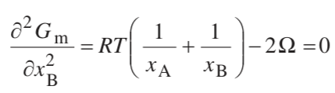


Construction of a Phase Diagram Based on Fluctuations
Consider the Hildebrand Model
Binodal phase equilibria is defined by
x_{A} = 1-x_{B} and d(ln(x)) = dx/x
Spinodal is defined by
Critical Point is defined by
d³G_{m}/dx_{B}³ = RT(1/(1-x_{B})² - 1/x_{B}²) = 0 or x_{A} = x_{B} = 0.5
Using this composition in d²G_{m}/dx_{B}² = 0 yields

Slide 12
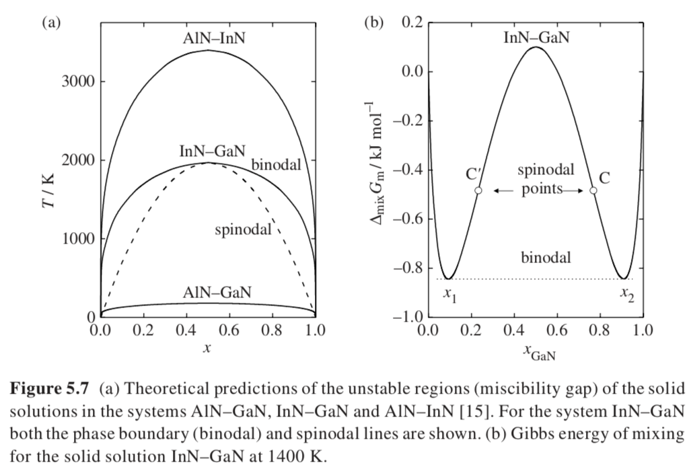
Hildebrand Equation

Slide 13
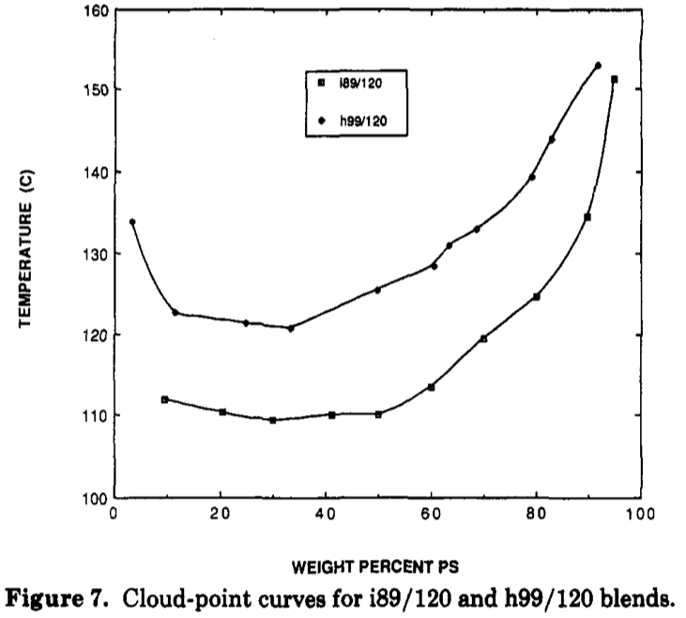


If Ω = -A + BT, and the entropy term is small (for polymers for instance) B is non-combinatorial entropy
Phase separation occurs on heating: Lower Critical Solution Temperature (LCST)
Flory-Huggins Equation
φ_{A} is the volume fraction of A
N_{A} is the number of “c” units in A
n_{c} is the total number of c volume units in the system
C is an average of A and B units
Volume fraction has replaced mole fraction
is an average interaction energy per c site per RT
~ Ω/RT
Symmetric blend N_{A} = N_{B}
Entropy part is small since N_{i} ~ 100,000
χ ~ a - b/T leads to LCST behavior, “a” is non-combinatorial entropy, “b” is the enthalpy of specific interactions that leads to miscibility
2 Phase
1 Phase

Slide 14
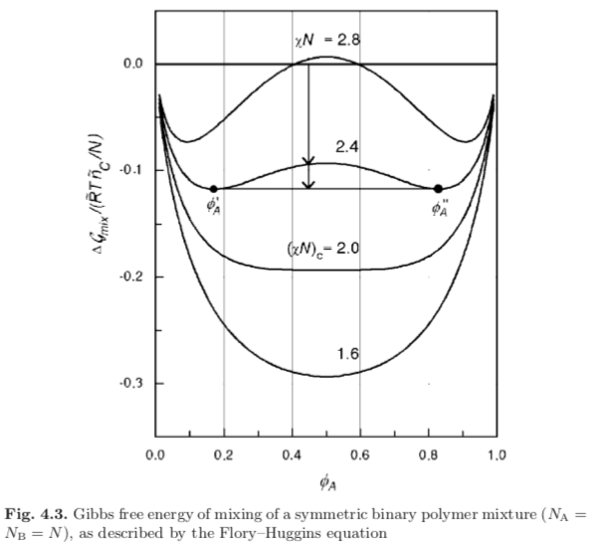
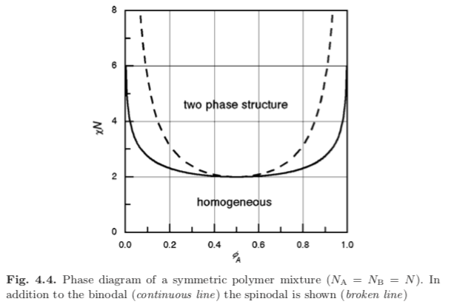
Since χN depends on 1/T specifying χN specifies the temperature. Large χN is low tempearature.

Slide 15
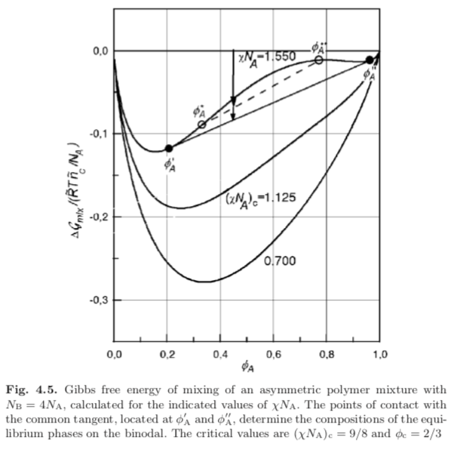

Slide 16
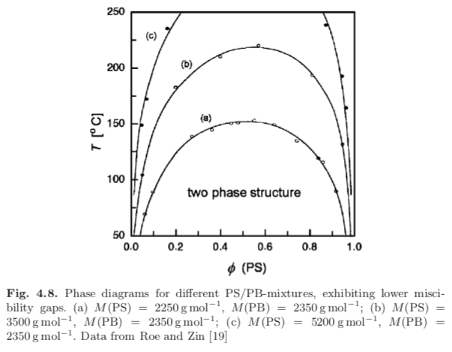
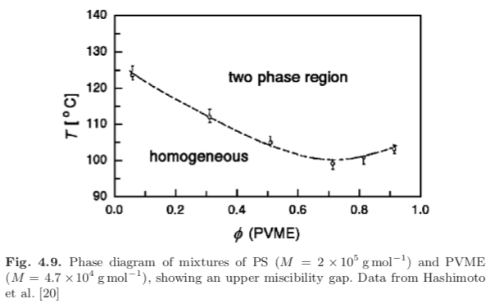
Joon Roe

Slide 17
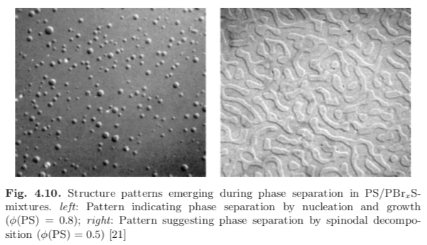
Spinodal
B
B

Slide 18
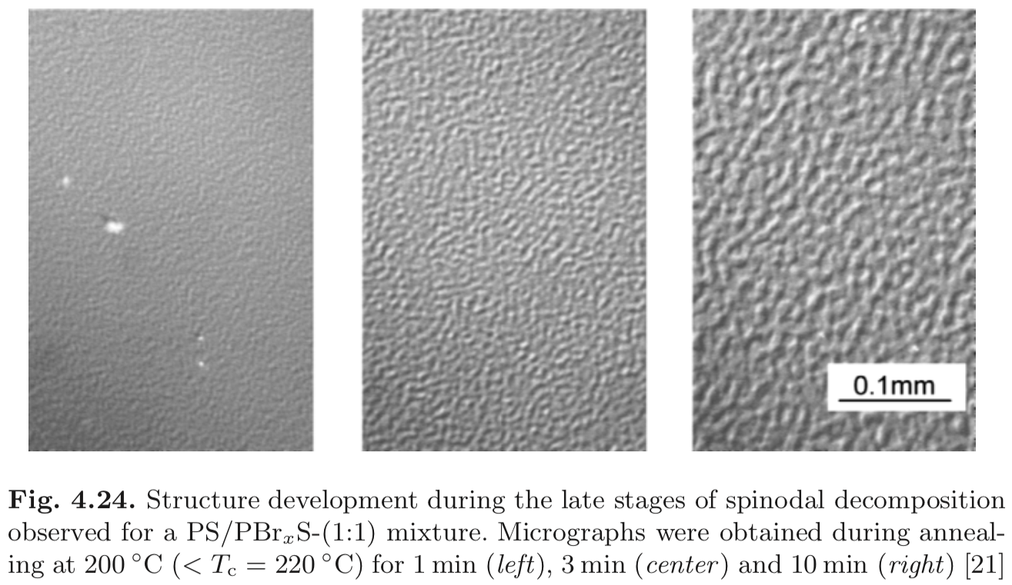
Spinodal
B
B

Slide 19
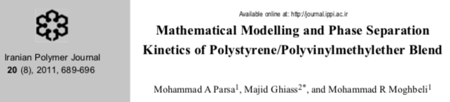
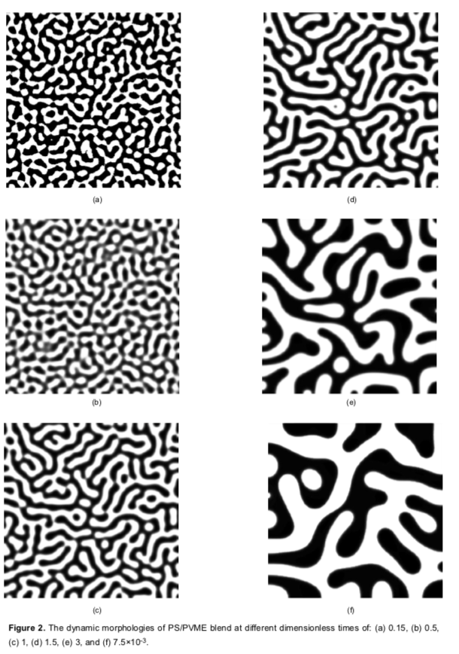
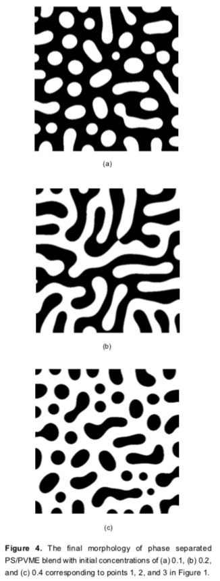
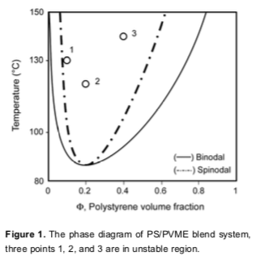
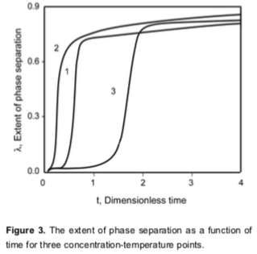

Slide 20
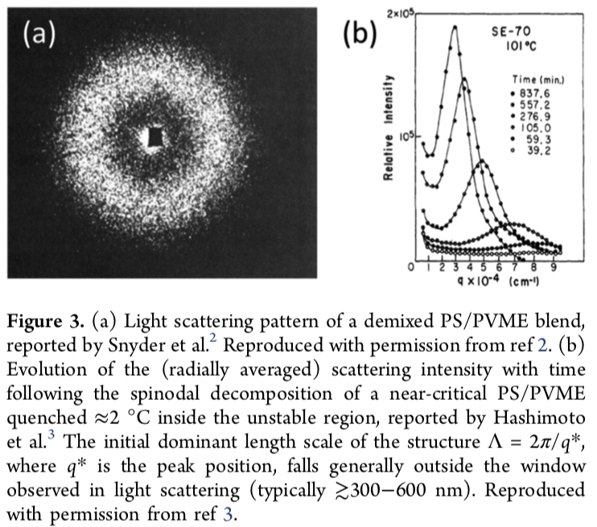
Higgins JS, Cabral JT A Thorny Problem? Spinodal Decomposition in Polymer Blends Macromolecules 53 4137−4140 (2020)

Slide 21
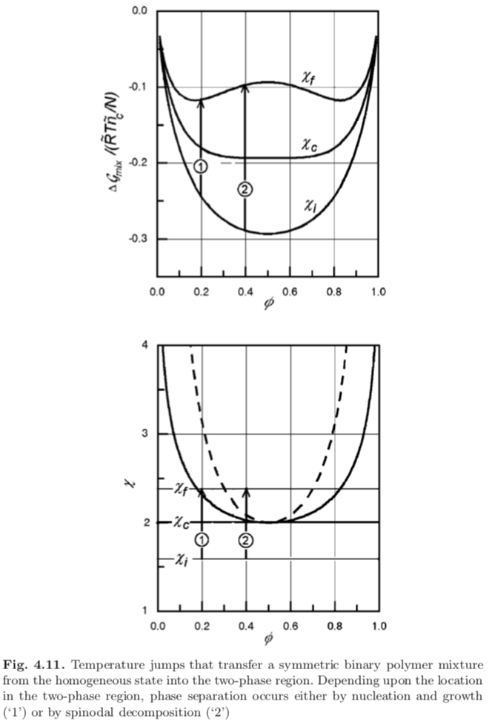
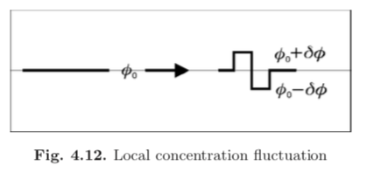


Free energy density
Series expansion of the free energy density yields,
Positive second derivative leads to increase (Stable)
(Smile up)
Negative to decrease (Phase Separation)
(Frown down)
P. 125 Strobl Chapter 4

Slide 22
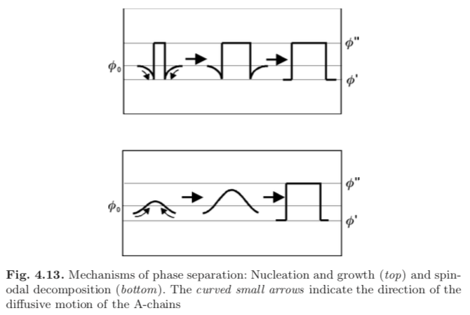
Diffusion in Nucleation and Growth and in Spinodal Decomposition
Fickian diffusion down a concentration gradient
Spinodal diffusion up a concentration gradient driven by free energy

Slide 23
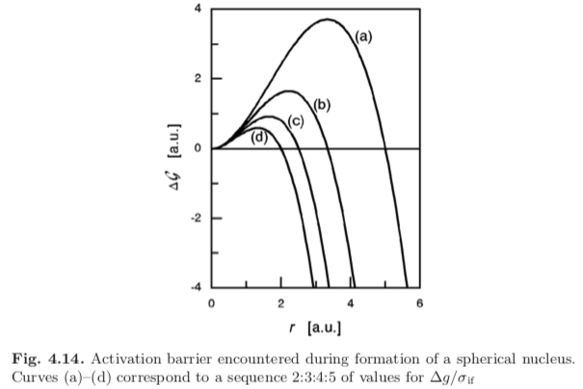
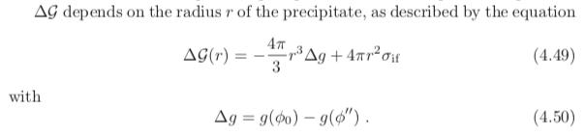


Diffusion in Nucleation and Growth
P. 127 Strobl Chapter 4
Rate of Nucleation
Free energy Barrier

Slide 24
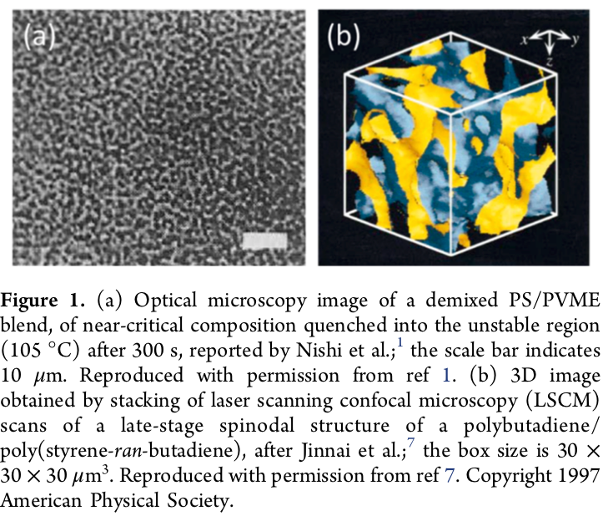
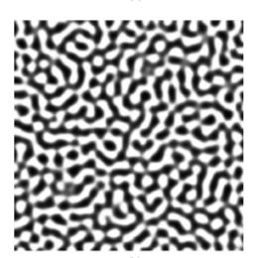
Phase grows from fluctuations
Higgins JS, Cabral JT A Thorny Problem? Spinodal Decomposition in Polymer Blends Macromolecules 53 4137−4140 (2020)

Slide 25
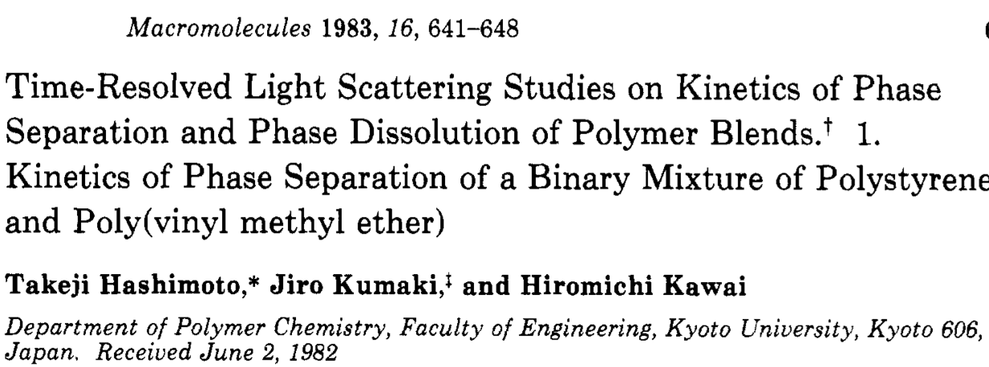

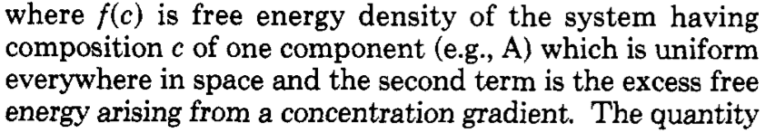
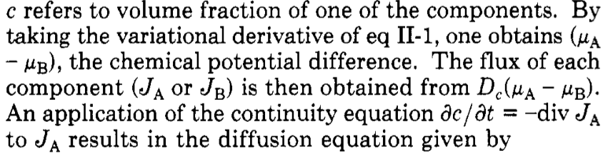

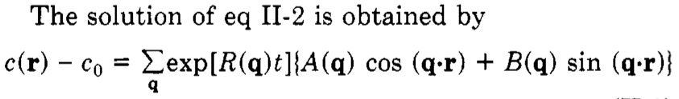
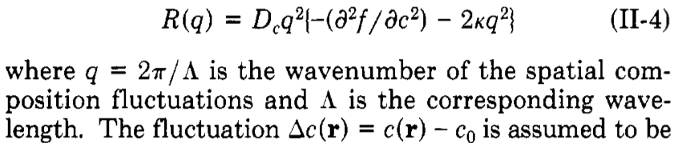
Growth rate at q

Slide 26

Flory-Huggins with a gradient term

Slide 27
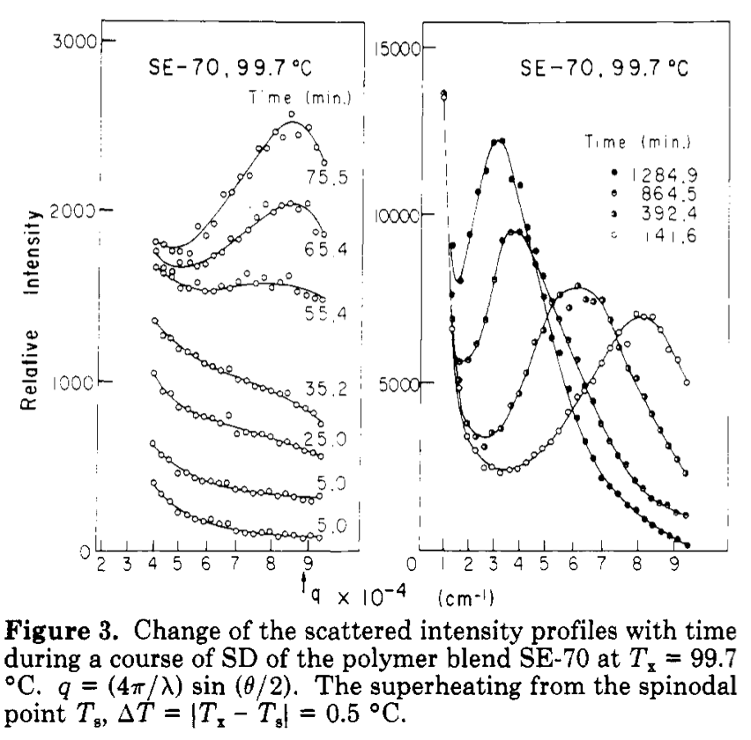
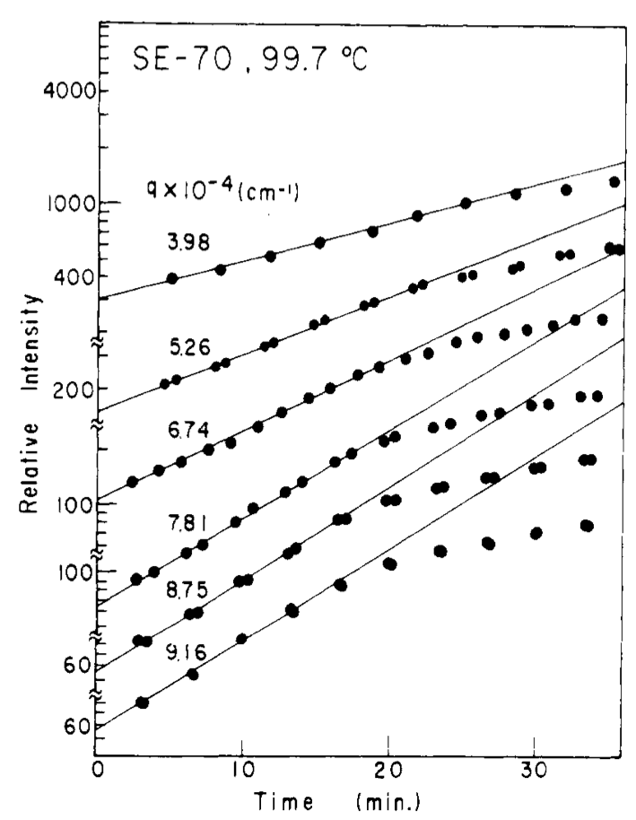

R(q) can be measured by light scattering
For Polymers
(X-ray or neutron for metals/ceramics)

Slide 28
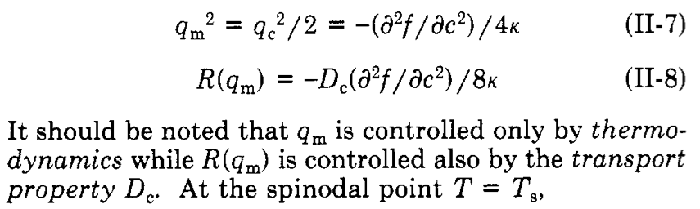
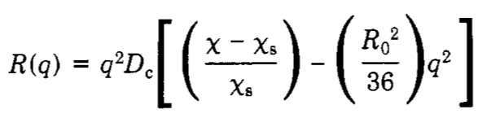
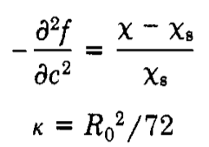
Transport
Size
(Entropy of the gradient)
Thermodynamics

Slide 30
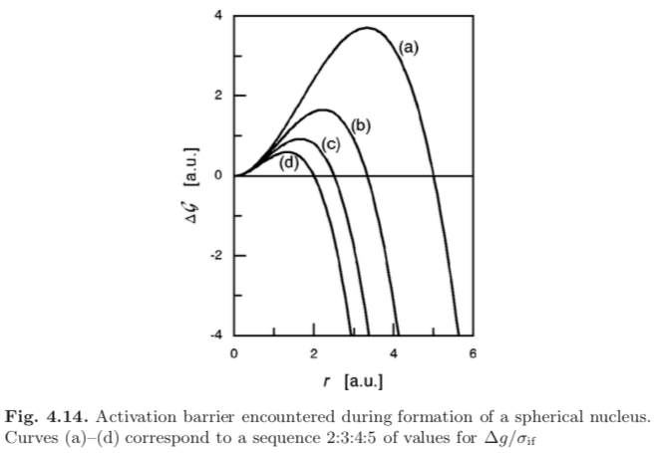
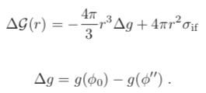


Activation Barrier for Nucleation and Growth
Different relative bulk to surface free energies (small to large)
Rate of Nucleation
Free energy Barrier
Balance between bulk and surface
Free energies
(Next chapter)

Slide 31
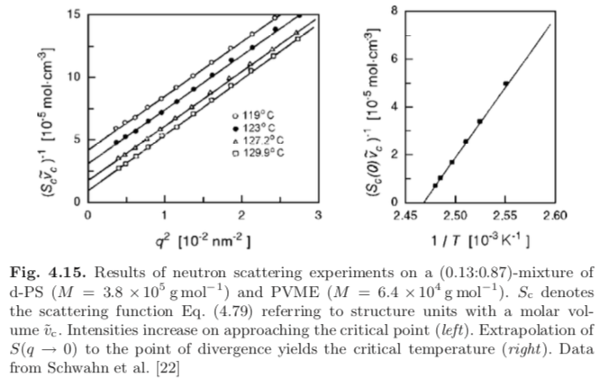
Critical Scattering from Single Phase Polymer Melt (neutron scattering 10Å)
A polymer chain in a melt is a random walk like a diffusion path so Mass ~ size²
By Bragg’s law size is related to inverse angle
d = 2/(λ sinθ)
Reduced angle is q = 4π/λ sinθ
Intensity (S) scales with Mass
So, S ~ q⁻²
Then a plot of 1/S vs q² should be a line that reflects the inverse of contrast at q = 0
At the critical point contrast goes to ∞ so 1/S goes to 0.
Deuteration provides contrast for neutrons, λ = 10Å.

Slide 32

After a T-jump to the 2-Phase region (Light Scattering 0.6 µm)

Slide 33

Vycor and Pyrex Glass
Na₂B₈O₁₃-SiO₂

Slide 34
Vycor
Pure fused silica is difficult to shape
Adding boron trioxide makes the melt more formable
Phase separation in the spinodal region leads to continuous phases
The boron can be leached out using acid leading to 96% silica in a simple process
Pure fused silica is very strong and resists thermal shock due to low thermal expansion coefficient
(High precision lenses)
If the glass is not reheated to remove the pores it can be used as a filter or water absorber
Pyrex
Adding boron trioxide makes the melt more formable and have a lower thermal expansion coefficient (1911).
Phase separation in the binodal region leads to boron domains in a silica matrix. This composition is used for CorellewareTM
2-phase white translucent ceramic

Slide 35

van der Waals Equation
(isothermal plot)
(dP/dV)_{T} = -(dT/dV)_{P} (dP/dT)_{V} Triple Product Rule
= - (1/α) (α/κ) First by def. second from Cp Cv calc.
= -1/κ
So, the P vs. V plot must have a negative slope!!
Positive slope part is imaginary
In the miscible region, changes in V occur by
converting liquid to solid or solid to liquid
at constant P so (dP/dV)_{T} = 0 in the 2-phase region.

Slide 36









At T_{c}, P_{c}
Van der Waals
At the critical point
T/T_{c} = 1
P ~ 1/V ideal gas
In two phase region
isothermal
Common Tangent Method for
T/T_{c} = 0.8
Is unphysical
Negative compressibility
Maxwell equal area construction

Slide 37

P ~ T ideal gas
isochoric
isobaric
Vapor pressure of water

Slide 38


Polymorphs and Allotrophs
Allotroph of a single element: Carbon as diamond or graphite
Polymorph of a compound:
Titania as anatase or rutile
Silica as α-quartz, β-quartz, tridymite, cristobalite, moganite, coesite,
and stishovite
Calcium carbonate as calcite or argonite
Ostwald’s rule: Most stable polymorph does not always crystallize, rather, meta-stable polymorphs form at a higher rate if the surface tension difference between the melt/liquid solution and the polylmorph is small.
Ostwald ripening: Metastable polymorphs may form small crystals. Over time stable polymorphs grow from these small crystals into large crystals. This has been generalized to growth of large phases due to ripening such as in crushed ice or ice cream.
Ostwald-Freundlich Equation: Small crystals dissolve more easily than large crystals. This is the reason for Ostwald ripening. Also true for vapor pressure of a liquid droplet (replace x with p)
Ostwald step rule: Least stable polymorph crystallizes first since it has
a free energy that is closest to the liquid or solution state. This means that metastable phases form kinetically first if they exist. If many polymorphs exist, they will form in order of free energy with the highest forming first.

Slide 39




1 Nucleation, 2 diffusion-limited growth, and 3 Ostwald ripening/coalescence.

Slide 40




Slide 41


Slide 42

Piezoelectric

